Slide 1
SOLUTION APPROACH (TECHNICAL DETAILS)
Göksenin Hande Bayazıt

Slide 2
Solutions
Image processing based
Motion-sensing based

Slide 3
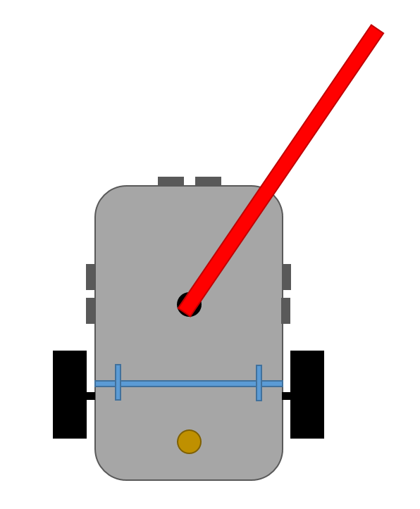
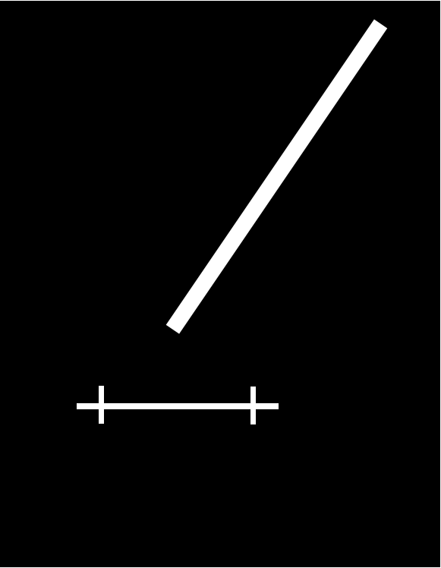

Slide 4
